Slide 1

PROGRAMMING (Basics)
Sunil Nadella
M.Sc.,M.Tech., M.Phil.,PGDCS.,(Ph.D)
UGC NET (Computer Science & Applications)
AP SET (Computer Science & Applications )
TS & AP SET (Mathematical Sciences)
Gold Medalist from Andhra University
http://sunilnadella.googlepages.com

Slide 2
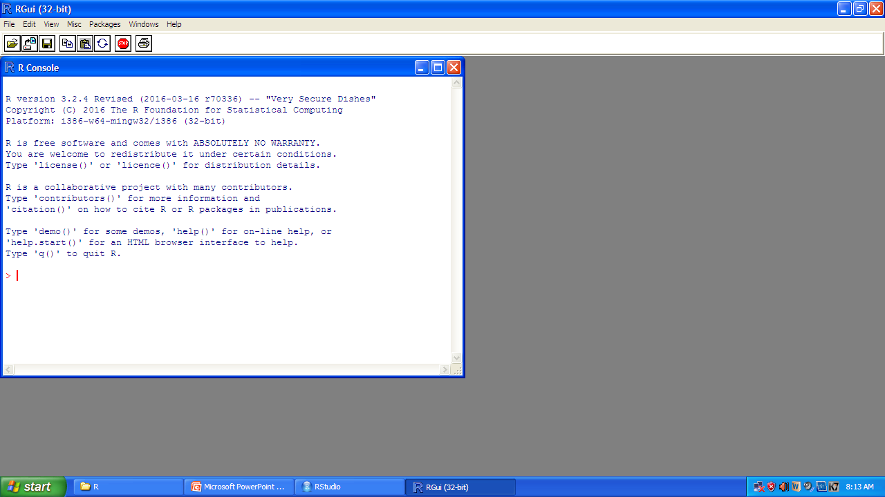

Slide 3
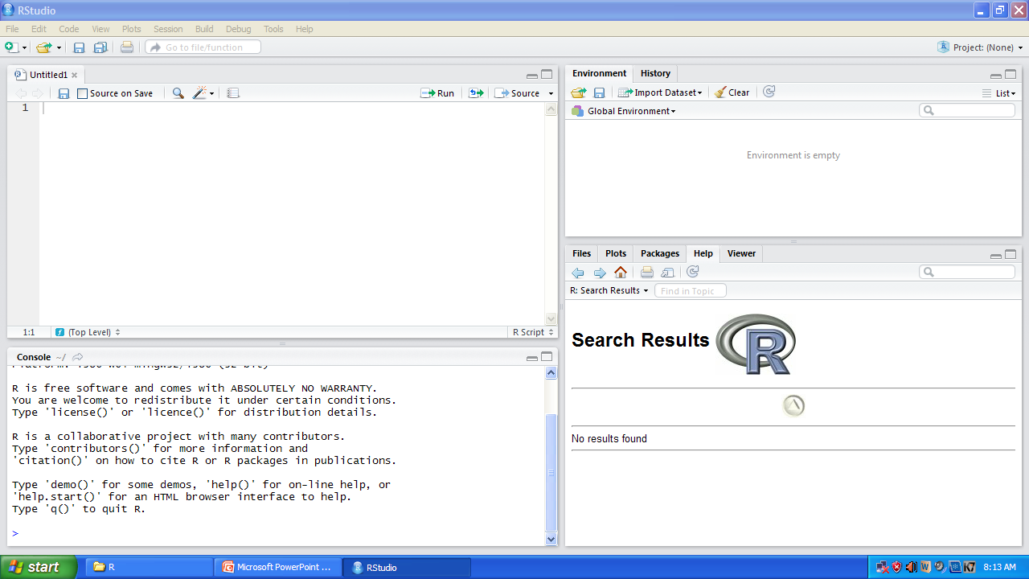

Slide 4

We interact with R by typing something into the console at the command prompt and pressing enter

Slide 5
ARITHMETIC OPERATORS IN R
ARITHMETIC OPERATORS IN R
+ | ADDITION
- | SUBTRACTION
* | MULTIPLICATION
/ | DIVISION
^ | RAISED TO THE POWER

Slide 6


Example 1 compute 22*15+6
> 22*15+6
[1] 336
>
Example 2 compute 22*(15+6)
> 22*(15+6)
[1] 462
>
Example 3 compute
> 22^2+7
[1] 491
>
Example 4 compute
> 22^(2+7)
[1] 1.207269e+12
>

Slide 7

Example 5 compute (2*(17.2+5))/56
>(2*(17.2+5))/56
[1] 0.7928571
>
Example 6 computer 3*5
> 3*5
[1] 15
>
Example 7 compute
> 5^2
[1] 25
>
Example 8 add 8 to 22 and then multiply answer by 3
>(8+22)*3
[1] 90
>

Slide 8
Example 9 subtract 2.8 from 12 and then raise the answer to the power of 1.5 plus 1.3924
> (12-2.8)^1.5+1.3924
[1] 29.29738
>
Example 10 divide 8 by 2.5 and then divide the answer by 3
> (8/2.5)/3
[1] 1.066667
>
Example 11 divide 2.5 by 3 and subtract the answer from 3
> 8-(2.5/3)
[1] 7.166667
>

Slide 9
ARITHMETIC OPERATORS IN R
PRECEDENCE OF ARITHMETIC OPERATORS IN R
1 | PARENTHESIS
2 | EXPONENTIATION
3 | MULTIPLICATION & DIVISION
4 | ADDITION & SUBTRACTION

Slide 10
ARITHMETIC OPERATORS IN R
SIMPLIFICATION OF ARITHMETIC OPERATORS IN R
1 | R simplifies the calculations from left to right
2 | Fist all calculations in brackets
3 | Then multiplication and division
4 | Then addition and subtraction

Slide 11
OBJECTS IN R
Simple calculations like arithmetic calculations do not produce any kind of out put that is remembered by R, the answer first appear in the console window but that’s all
If we want to do further calculations with the answer to a calculation you need to give it a name and tell R to store it as an object
For storing the objects we use the symbol ← called allocation symbol also called gets .

Slide 12
Functions ls() and rm()
ls()
When we first open R then there are no objects stored, but after we have been using it for a while we might have lots
The ls() function is used to get the list of objects stored
rm()
we remove an object by using the function rm()
The rm() function doesn’t ask if you are sure or give you any other sort of warning nor does it is done as you asked
It generates an error message when we try to remove an object which is not there.

Slide 13
EXAMPLES
Example -1 : ls() at the starting of R
> ls()
character(0)
>
Example -2 : creating an object a which is the number 23
> a<-23
> a
[1] 23
>
Example -3 : another way of solving Example-2
> a=23
> a
[1] 23
>
Example -4 : use ls() function to list object created in example-2
>ls()
[1] "a“
>

Slide 14
EXAMPLES
Example -5 : create an object called a which is the answer to the sum 23+246
>a<-23+246
> a
[1] 269
>
Example -6 : create two objects a, b with values 23 and 46 respectively and list them using ls()
> a=23
> b=46
> ls()
[1] "a" "b“
>

Slide 15
EXAMPLES
Example -7 demonstrate ls() function
> X=23
> Y="SUNIL"
> X
[1] 23
> Y
[1] "SUNIL"
> ls()
[1] "X" "Y”
>

Slide 16
EXAMPLES
Example -11 : create an object called “x1” which is the number 73
> x1<-73
> x1
[1] 73
>
Example -12: create an object called “x2” which is the answer to the sum 101 + 36
> x1
[1] 73
> x2<-101+36
> x2
[1] 137
>

Slide 17
EXAMPLES
Example -13 multiply “x1” and x2 together and store he object as anoter object called x3
> ls()
[1] "x1" "x2"
> x1
[1] 73
> x2
[1] 137
> x3<-x1*x2
> x3
[1] 10001
>

Slide 18
EXAMPLES
Example -14 subtract 1 from x3 and calculate the 4th root
> ls()
[1] "x1" "x2"
> x1
[1] 73
> x2
[1] 137
> x3<-x1*x2
> x3
[1] 10001
> (x3-1)^(1/4)
[1] 10
>

Slide 19
FUNCTIONS
R is not so much a statistical package in the traditional sense, like Mintab but is really a programming language designed to be good for carrying out statistical analysis
R comes with a huge variety of short ready made pieces of code that will do things like manage your data, do more complex mathematical operations on your data, draw graphics and carry out statistical analysis ranging from the simple and straight forward to the eye watering complex these ready made pieces of code are called Functions.
Each function name ends in a pair of brackets
For many of he more straight forward functions you just type the name of the function and put the name of the object you would like the procedure carried out on in the brackets

Slide 20
MATHEMATICAL FUNCTIONS IN R
FUNCTION | DESCRIPTION
exp() | To find exponent for the given number
log() | Logarithm of a number with base value
log10() | Logarithm of base 10 number
sqrt() | Finds square root of a number
min() | Find minimum value in an array
max() | Find maximum value of an array
sum() | Find sum of numbers in an array
sort() | Sorts an array in increasing order
sort(x, decreasing=TRUE) | Sorts an array in decreasing order
round() | Round off a number

Slide 21
MATHEMATICAL FUNCTIONS IN R
TRIGNOMETRIC FUNCTIONS
FUNCTION | DESCRIPTION
sin(x) | Trigonometric function to calculate sin value x
cos(x) | Trigonometric function to calculate cos value x
tan(x) | Trigonometric function to calculate tan value x
asin(x) | Trigonometric function to calculate arc-sin value x
acos(x) | Trigonometric function to calculate arc-cos value x
atan(x) | Trigonometric function to calculate arc-tan value x
atan2(y, x) | Trigonometric function to calculate tan value for a given two elements or vectors

Slide 22
MATHEMATICAL FUNCTIONS IN R
TRIGNOMETRIC FUNCTIONS (Hyperbolic functions)
FUNCTION | DESCRIPTION
sinh(x) | Trigonometric function to calculate hyperbolic sin value x
cosh(x) | Trigonometric function to calculate hyperbolic cos value x
tanh(x) | Trigonometric function to calculate hyperbolic tan value x
asinh(x) | Trigonometric function to calculate hyperbolic arc-sin value x
acosh(x) | Trigonometric function to calculate hyperbolic arc-cos value x
atanh(x) | Trigonometric function to calculate hyperbolic arc-tan value x

Slide 23
MATHEMATICAL FUNCTIONS IN R
SET OPERATIONS
FUNCTION | DESCRIPTION
union(a, b) | It combines / contains all the vector elements in either vectors a or b or both
intersect(a,b) | It contains all the elements that are in both vectors a and b
setdiff(a,b) | It contains all the elements that are in vector a butt not in vector b
setequal(a, b) | Checks two vectors having same elements or not

Slide 24
MATHEMATICAL FUNCTIONS IN R
SPECIAL FUNCTIONS
FUNCTION | DESCRIPTION
beta(x, y) | Returns a beta function value where x and y are elements or vectors should be non negative
lbeta(x, y) | Returns a natural logarithm value of beta function where x and y are elements or vectors should be non negative
gama(x, y) | Returns a gama function value where x and y are elements or vectors should be non negative
lgama() | Returns a natural logarithm value of beta function where x and y are elements or vectors should be non negative

Slide 25
MATHEMATICAL FUNCTIONS IN R
SPECIAL FUNCTIONS
FUNCTION | DESCRIPTION
choose(n, x) | Used to return binomial coefficients of the given value where n is reall number and x is integer
lchoose(n, x) | Computes the logarithms of their absolute values where n is real number and x is integer
digamma(x) | Computes the first derivatives of the logarithm of the gamma function and returns it where x is an element or vector
trigamma() | Computes the second derivatives of the logarithm of the gamma function and returns it where x is an element or vector

Slide 26
FUNCTIONS
Function q() is used to quit the R
The function demo() demos in package base.
The function help() or help.start() for help in HTML form
Now we will see some of the commonly used Mathematical functions
Example-1 Natural log of 27
> log(27)
[1] 3.295837
>
Example-2 e raised to the power 3
> exp(3)
[1] 20.08554
>

Slide 27



FUNCTIONS
Example-3 compute square root of 225 that is
> sqrt(225)
[1] 15
>
Example-4 compute cube root of 125 that is
>125^(1/3)
[1] 5
>
Example-5 compute Absolute value or unsigned value of 9 that is
> abs(-9)
[1] 9
>

Slide 28


FUNCTIONS
Example-6 compute when x=2
> x<-2
> exp((x*2)^(1/3))
[1] 4.891021
>
Example-7 compute
> x<-4
> 1/sqrt(x)
[1] 0.5
>

Slide 29
FUNCTIONS
Till now we experimented the functions with single argument between the brackets
We can add more arguments by separating with commas
These extra arguments serve to do things like modify the way that the function is applied or tell it to only use part of a data set, or specify how function should deal with missing data points

Slide 30
FUNCTIONS
round()
rounds the values in its first argument to the specified number of decimal places (default 0).
ceiling()
takes a single numeric argument x and returns a numeric vector containing the smallest integers not less than the corresponding elements of x.
floor()
takes a single numeric argument x and returns a numeric vector containing the largest integers not greater than the corresponding elements of x.

Slide 31
FUNCTIONS
trunc()
takes a single numeric argument x and returns a numeric vector containing the integers formed by truncating the values in x toward 0.
signif()
rounds the values in its first argument to the specified number of significant digits

Slide 32
FUNCTIONS
Function round()
this function rounds off a number to a certain number of decimal places
Syntax : round(), round(x, number of digits)
Example 1 round 14.5378
> round(14.538)
[1] 15
>
Example 2 round 14.4378
> round(14.4378)
[1] 14
>

Slide 33
FUNCTIONS
Example 3 round 14.5378 to one decimal place
> round(14.5378,1)
[1] 14.5
>
Example 4 round 14.5378 to two decimal places
> round(14.5378,2)
[1] 14.54
>
Example 5 round 14.5378 to two decimal places
>round(14.5378,3)
[1] 14.538
>

Slide 34
FUNCTIONS
Example 4 round 14.5378 using ceiling() function
> ceiling(14.5378)
[1] 15
>
Example 5 round 14.9378 using ceiling() function
> ceiling(14.9378)
[1] 15
>
Example 6 round 14.0378 using ceiling() function
> ceiling(14.0378)
[1] 15
>

Slide 35
FUNCTIONS
Example 7 round 14.5378 using floor() function
> floor(14.5378)
[1] 14
>
Example 8 round 14.9378 using floor() function
> floor(14.9378)
[1] 14
>
Example 9 round 14.0378 using floor() function
> floor(14.0378)
[1] 14
>

Slide 36
FUNCTIONS
Example 10 round 14.5378 using floor() function
> trunc(14.5378)
[1] 14
>
Example 11 round 14.9378 using floor() function
> trunc(14.9378)
[1] 14
>
Example 12 round 14.0378 using floor() function
> trunc(14.0378)
[1] 14
>

Slide 37
FUNCTIONS
Example 13 let pi=3.141593 round pi using signif() to 5 digits
> pi=3.141593
> signif(pi,5)
[1] 3.1416
>
Example 14 let pi=3.141593 round pi using signif() to 4 digits
> signif(pi,4)
[1] 3.142
>
Example 15 let pi=3.141593 round pi using signif() to 3 digits
> signif(pi,3)
[1] 3.14
>
Example 16 let pi=3.141593 round pi using signif()
> signif(pi)
[1] 3.14159
>

Slide 38



FUNCTIONS
Example 17 compute
>logb(27, base=3.5)
[1] 2.630854
>
Example 18 compute
>logb(27, base=10)
[1] 1.431364
>
Example 19 compute
> logb(27, base=2)
[1] 4.754888
>

Slide 39
FUNCTIONS
Example 20 calculate the log 100 to the base of x1=10 using the function log()
> log(100, base=x1)
[1] 2
>
Example 21 compute the square root of x2=25 using function sqrt()
>x2<-25
> sqrt(x2)
[1] 5
>

Slide 40
FUNCTIONS
Example 22 compute the square root of x2 by raising it to the power 0.5
> x2<-25
> sqrt(x2^0.5)
[1] 2.236068
>
Example 23 using the function sum() compute 1+2
>sum(1,2)
[1] 3
>
Example 24 using the function sum() compute sum of 12, 23, 32, 45, 59
> sum(12,23,32,45,59)
[1] 171
>

Slide 41
FUNCTIONS
Example 25 compute the mean of 12,23,32,45,59 using sum() function
> s<-sum(12,23,32,45,59)
> n<-5
> m<-s/n
> m
[1] 34.2
>

Slide 42


